Slide 1



Nuclear Data Measurements at LANL and LBNL
Nuclear Science and Security Consortium
NPP/ND Review
Andrew S. Voyles
13 June 2018
Notes:
Emerging trends for next-generation (targeted & personalized) nuclear medicine:
Targeted alpha therapy (5-10 MeV)
40-80 μm range → single cell
Targeted Auger therapy (20 eV – 1 keV)
1 nm – 2 μm → cellular nucleus
Theranostic medicine
Simultaneous imaging and therapy

Slide 2
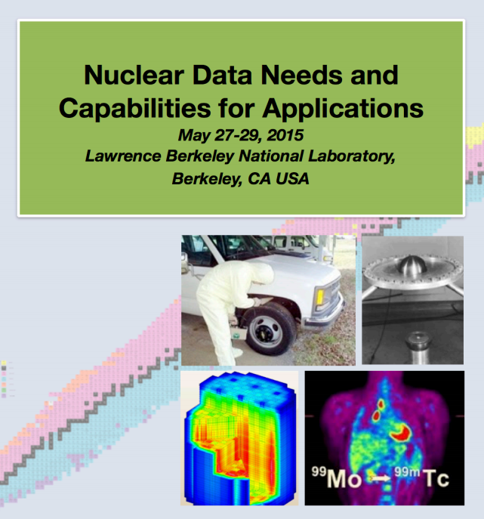
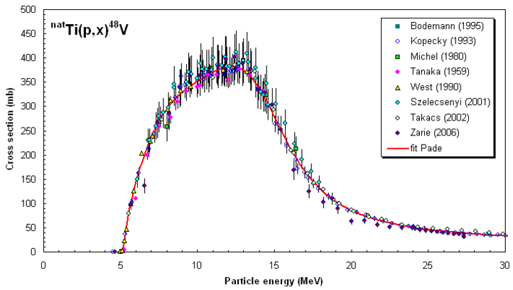
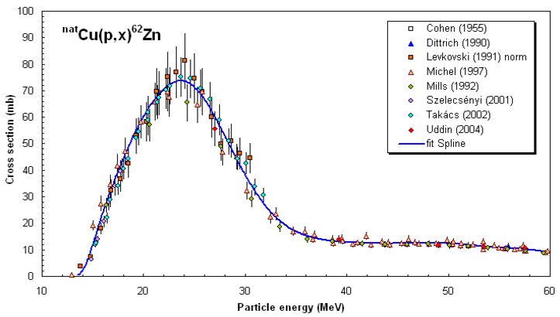
Measurements @ LANL – Nb(p,x)
Dosimetry was the top cross-cutting need in the NDNCA whitepaper
Vital for robust determination of fluence, energy for charged-particle measurements
Current data is deficient above ~30 MeV/A
nds.iaea.org/medical/monitor_reactions.html

Slide 3
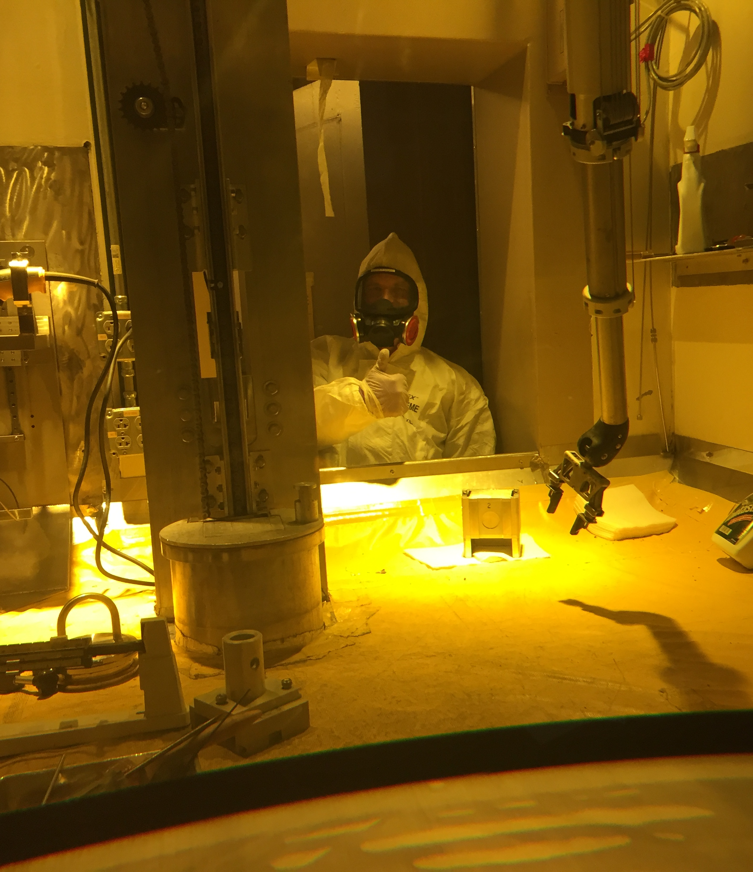
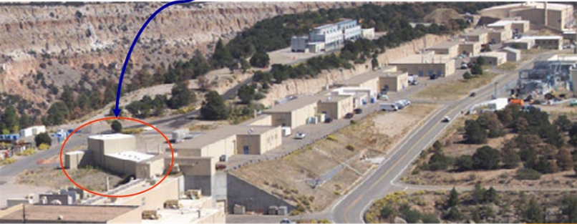
Measurements @ LANL – Nb(p,x)
Measurement performed in Jan-Feb 2017 at LANSCE-IPF (100 MeV proton beam)
IPF
Proton Injectors
201.25 MHz Drift Tube Linac
p+
805 MHz Side-Coupled Cavity Linac
To research centers
p+
p-
800 m
p-
750 keV
100 MeV
800 MeV
h+

Slide 4
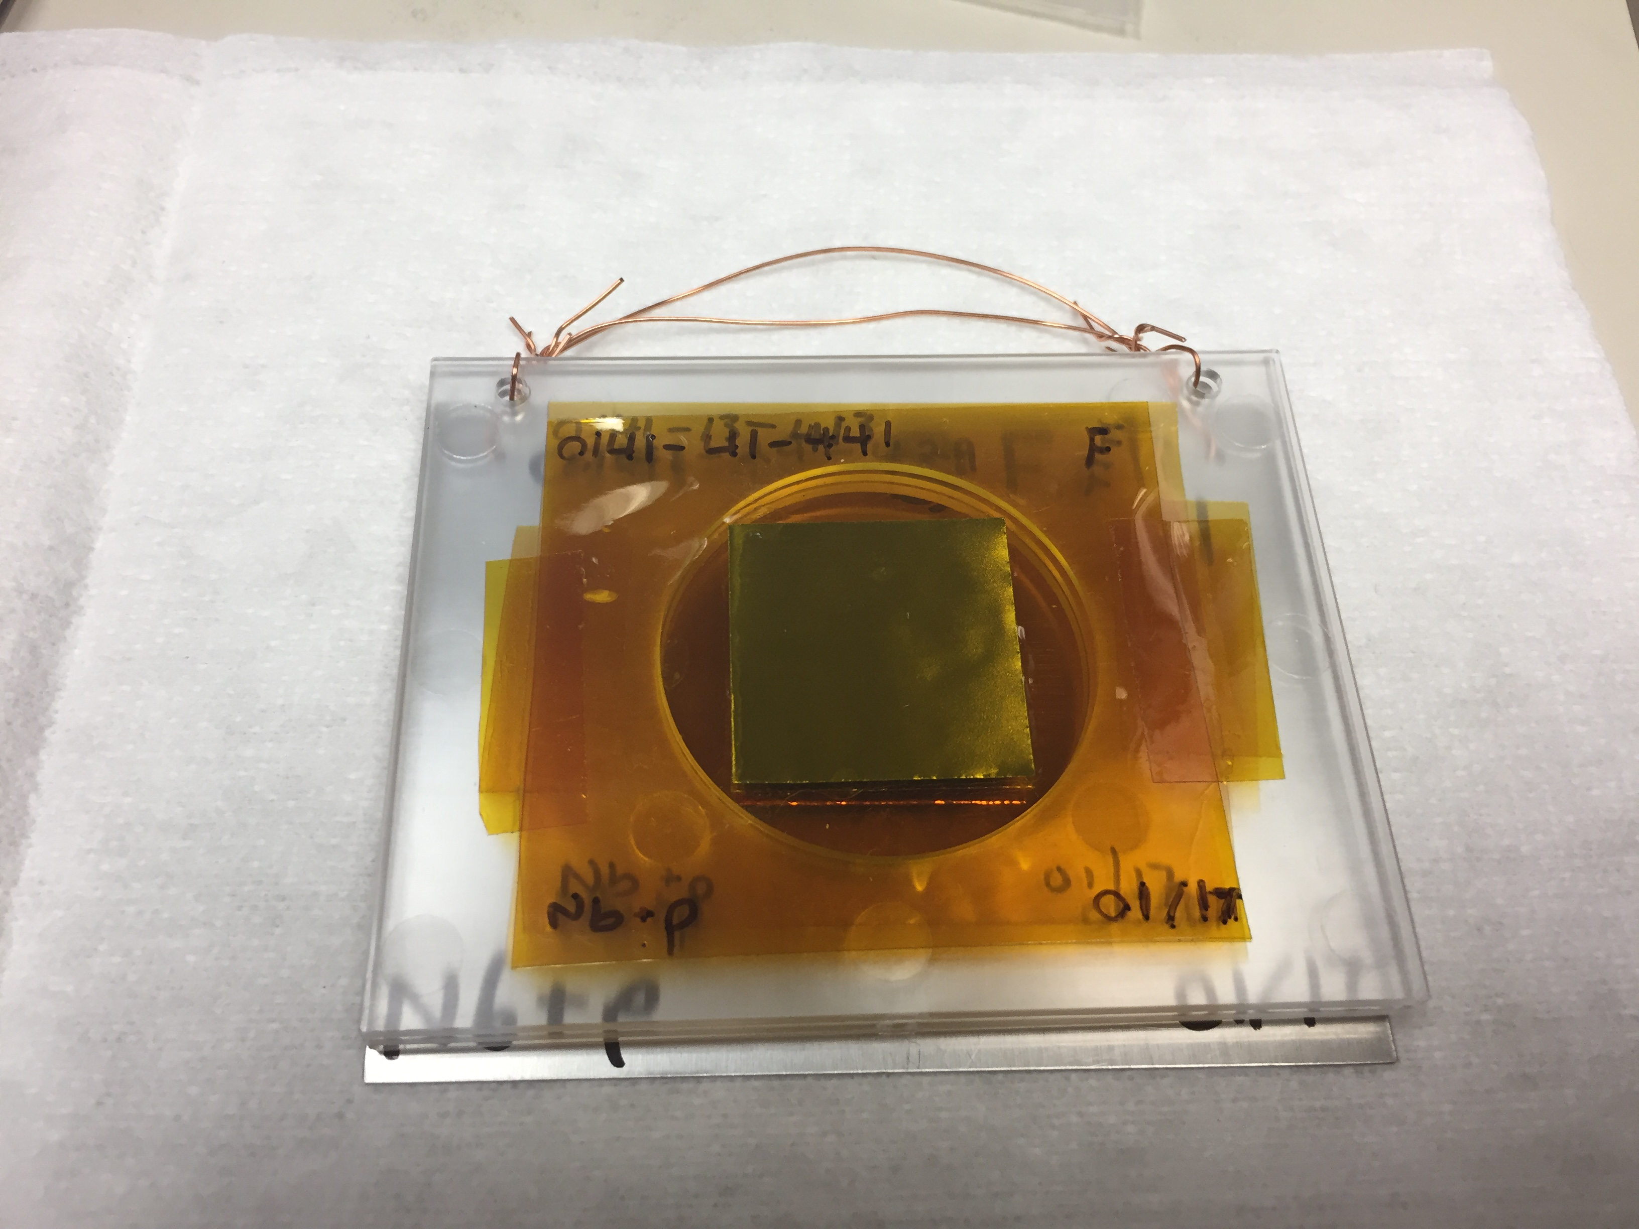
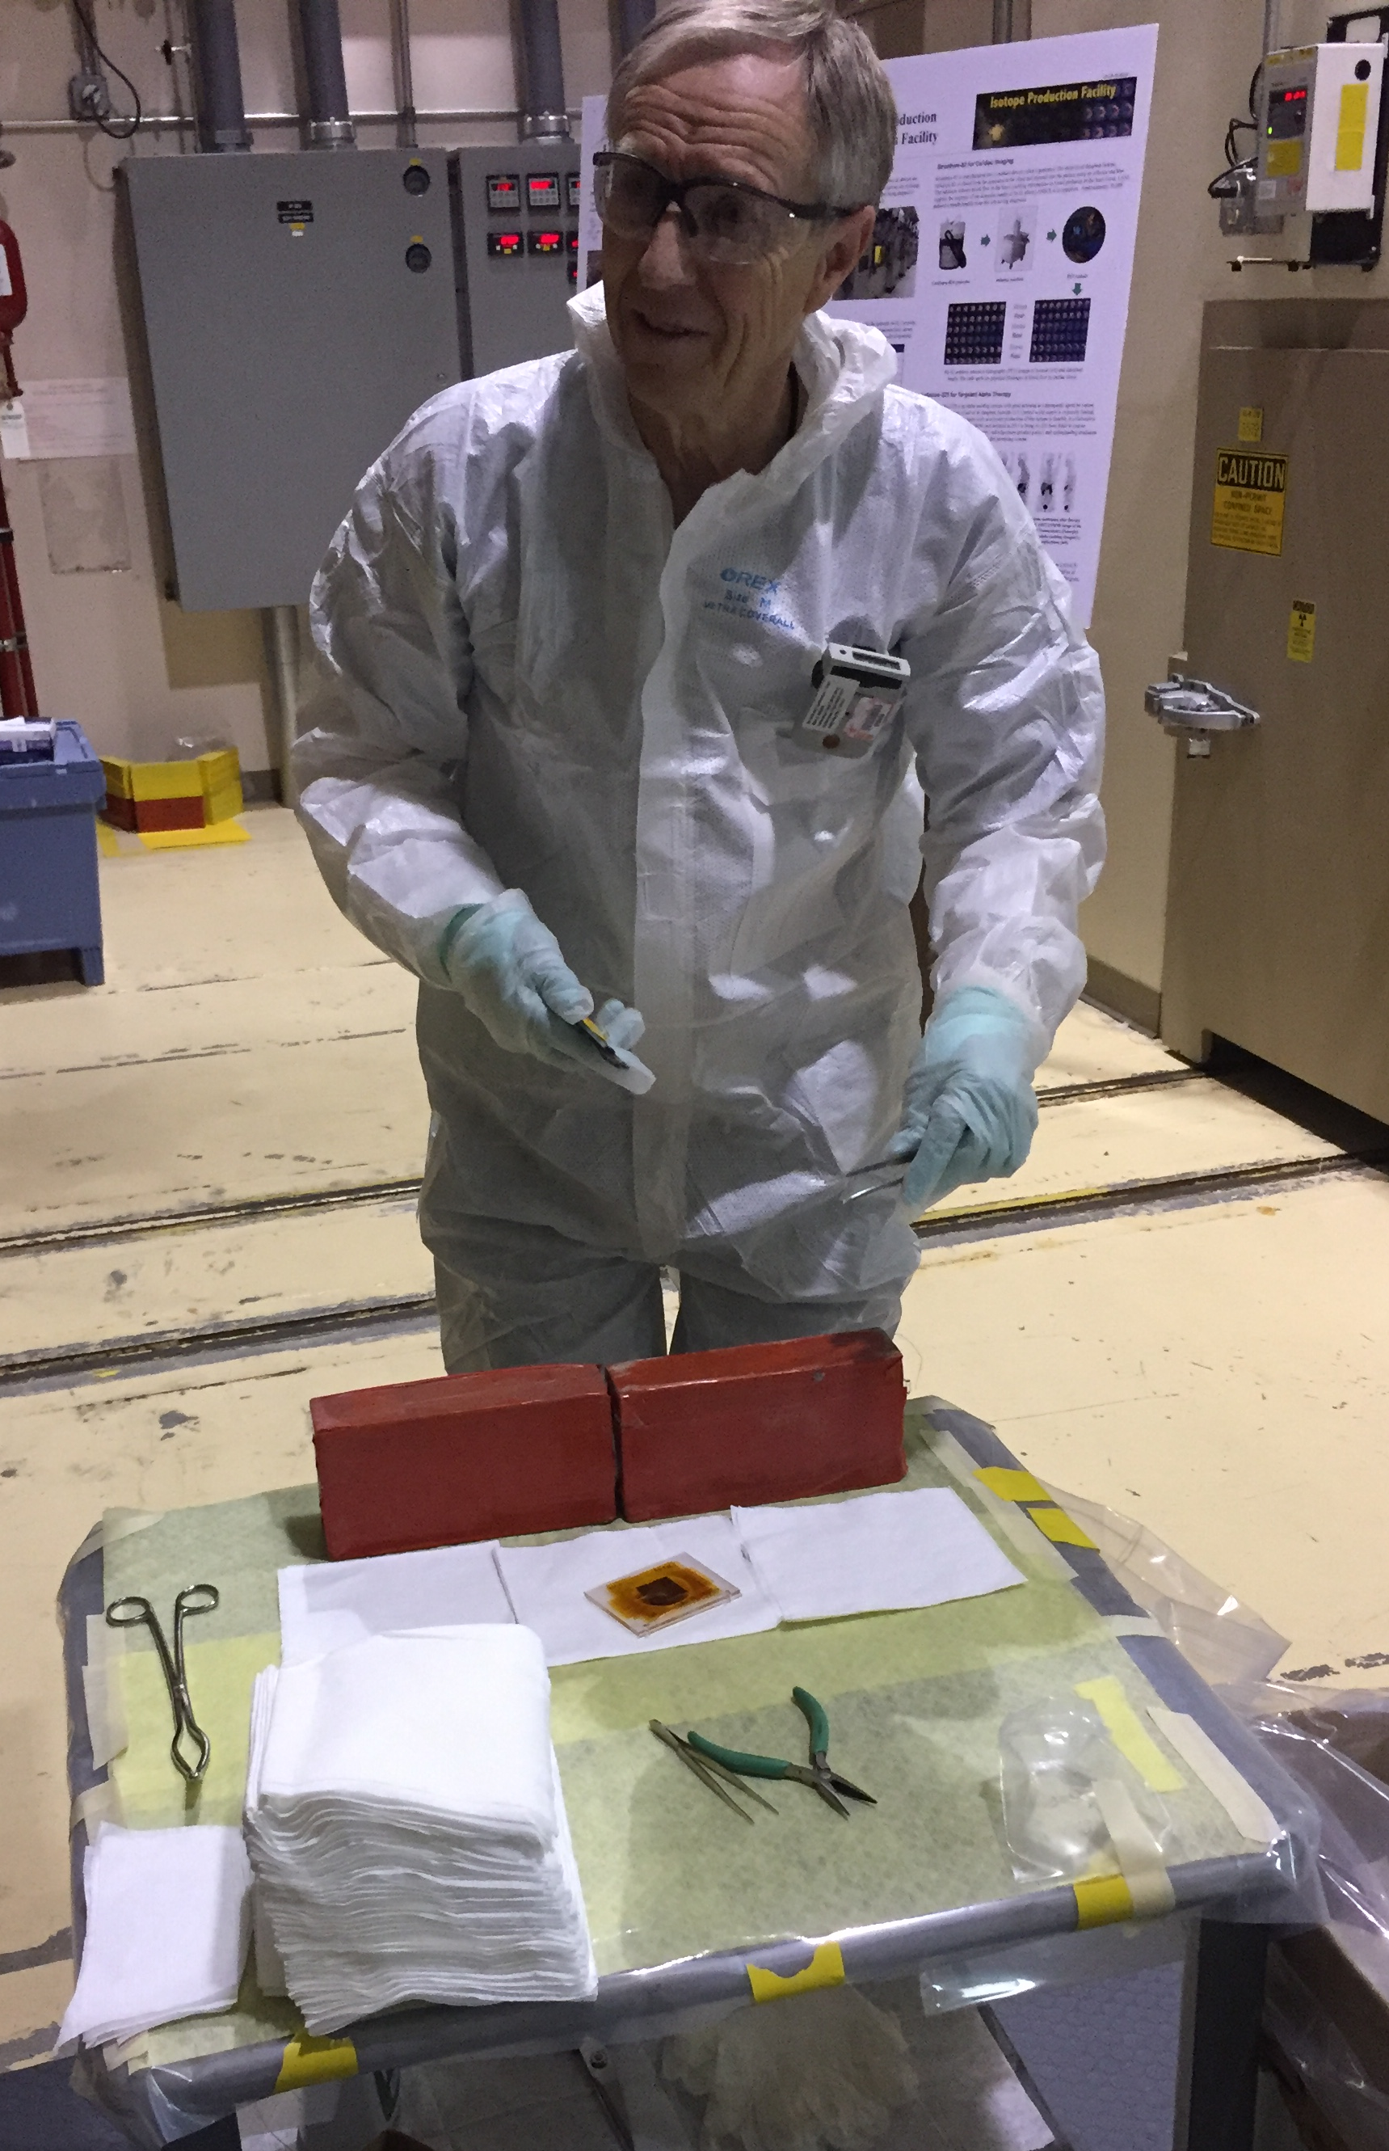
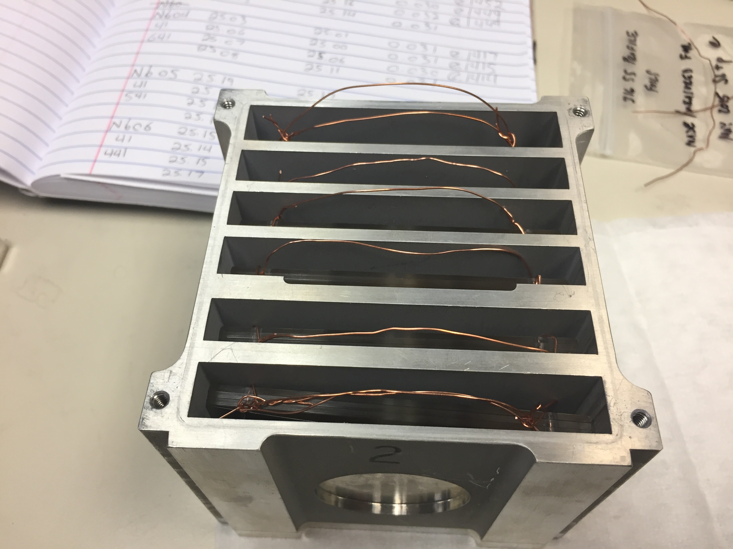
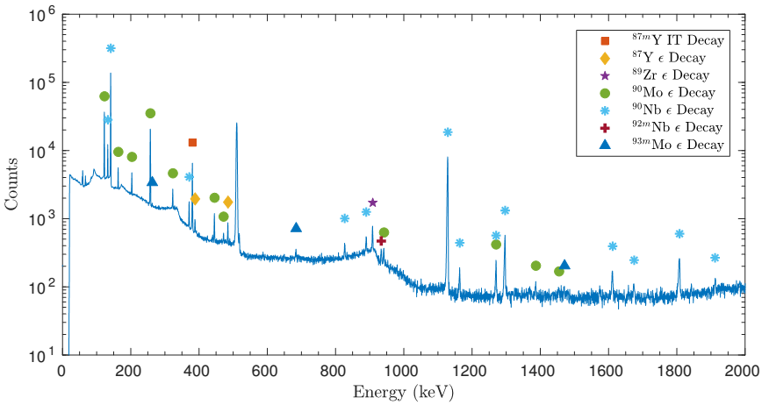
Measurements @ LANL – Nb(p,x)
^{nat}Nb(p,4n)⁹⁰Mo is a high-priority objective as a new proton beam dosimetry standard for E_{p} ≈ 40 – 200 MeV
Desired for use at facilities such as LANSCE-IPF, BLIP (BNL), iTHEMBA, etc.
Produced additional emerging radionuclides: ^{82m}Rb, ⁸⁶Y, ⁸⁹Zr, ⁹⁰Nb
M. Nortier
^{100 MeV p+}

Slide 5
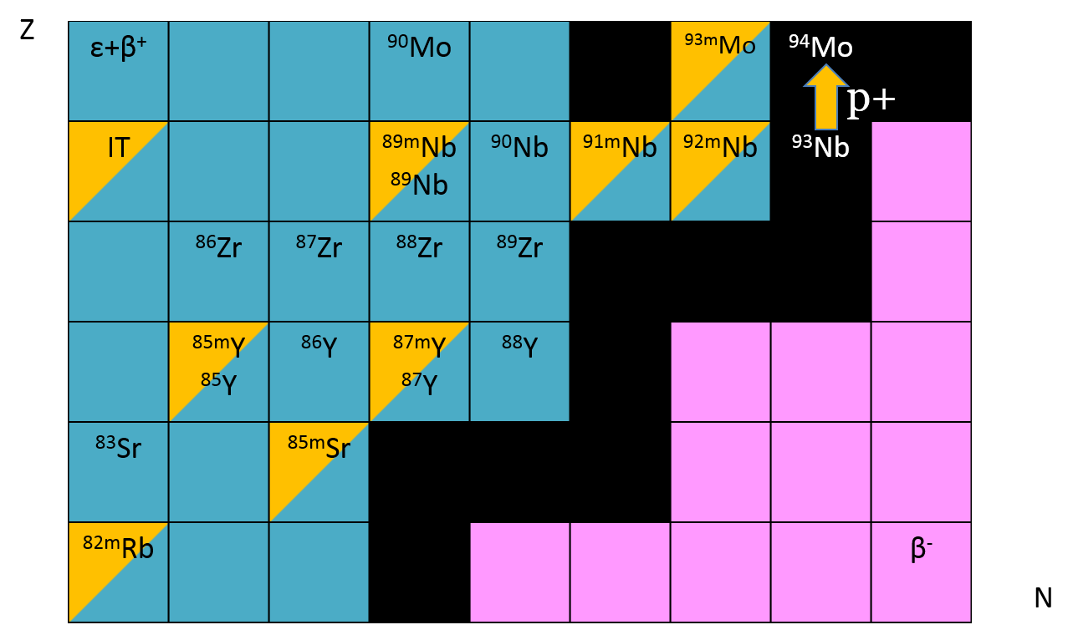
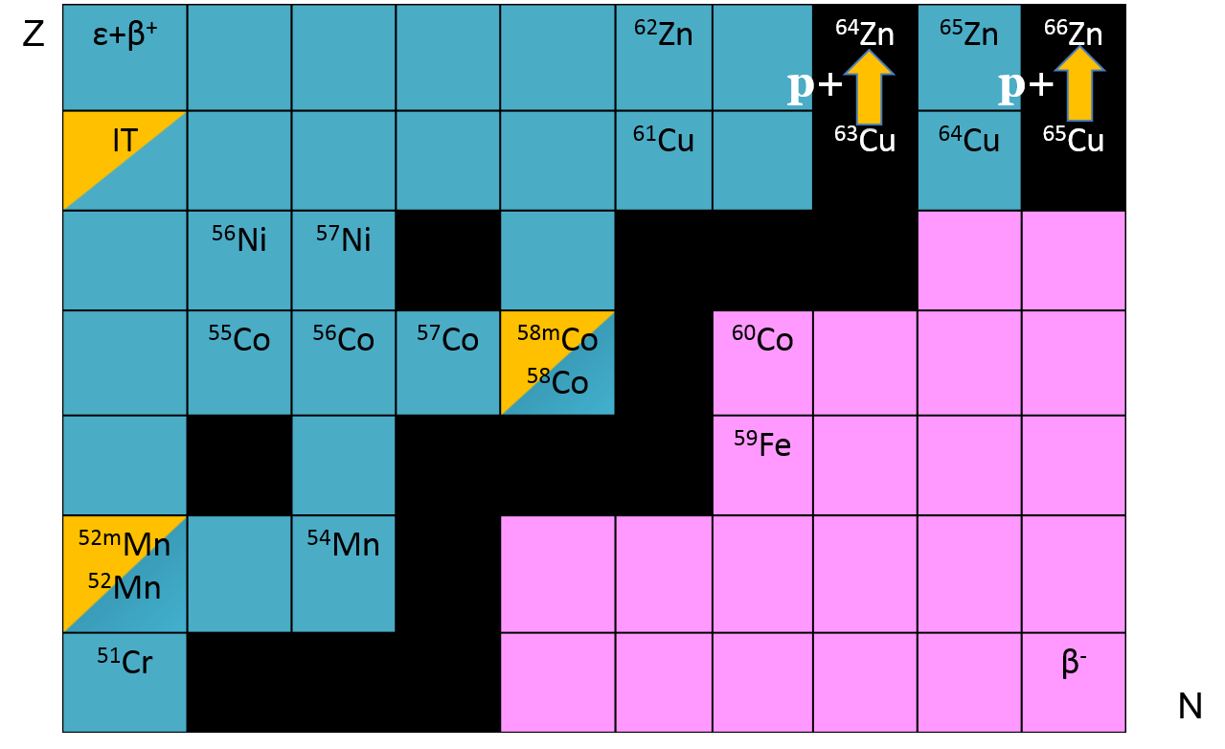
Measurements @ LANL – Nb(p,x)
Measurements of 38 cross-sections for ⁹³Nb(p,x) and ^{nat}Cu(p,x)
[1] A.S. Voyles, NIM B (2018)

Slide 6
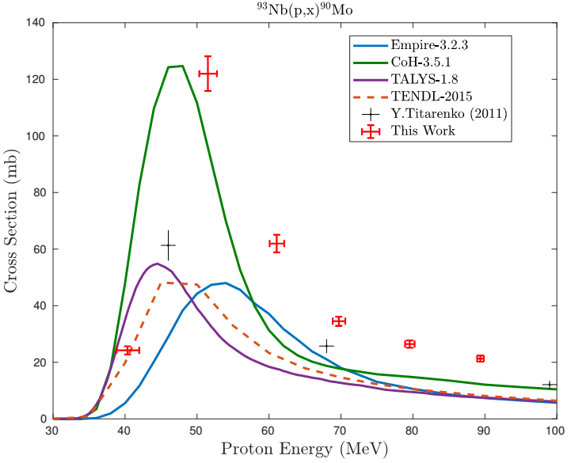
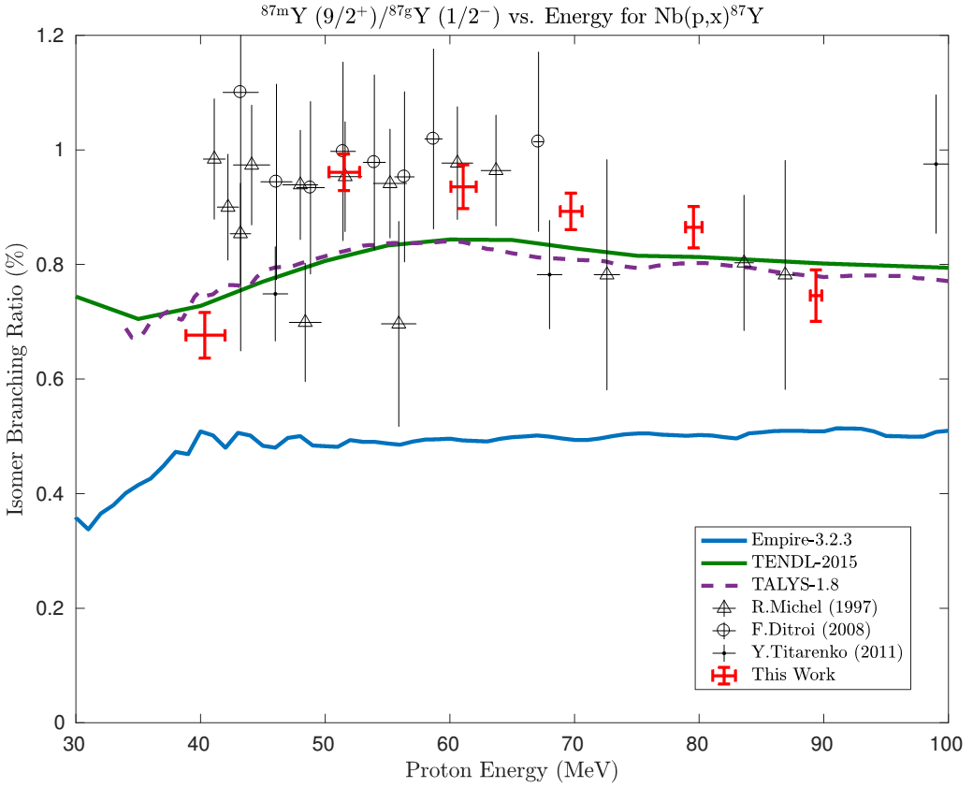
Measurements @ LANL – Nb(p,x)
5 independent measurements of isomer-to-ground state ratios
Results have been published, and are currently being compiled into EXFOR!
Next step: extend to 200 MeV
A.S. Voyles et al., “Excitation functions for (p,x) reactions of niobium in the energy range of E_{p} = 40–90 MeV”, NIM B, 429 (2018) 53–74. http://dx.doi.org/10.1016/j.nimb.2018.05.028

Slide 7
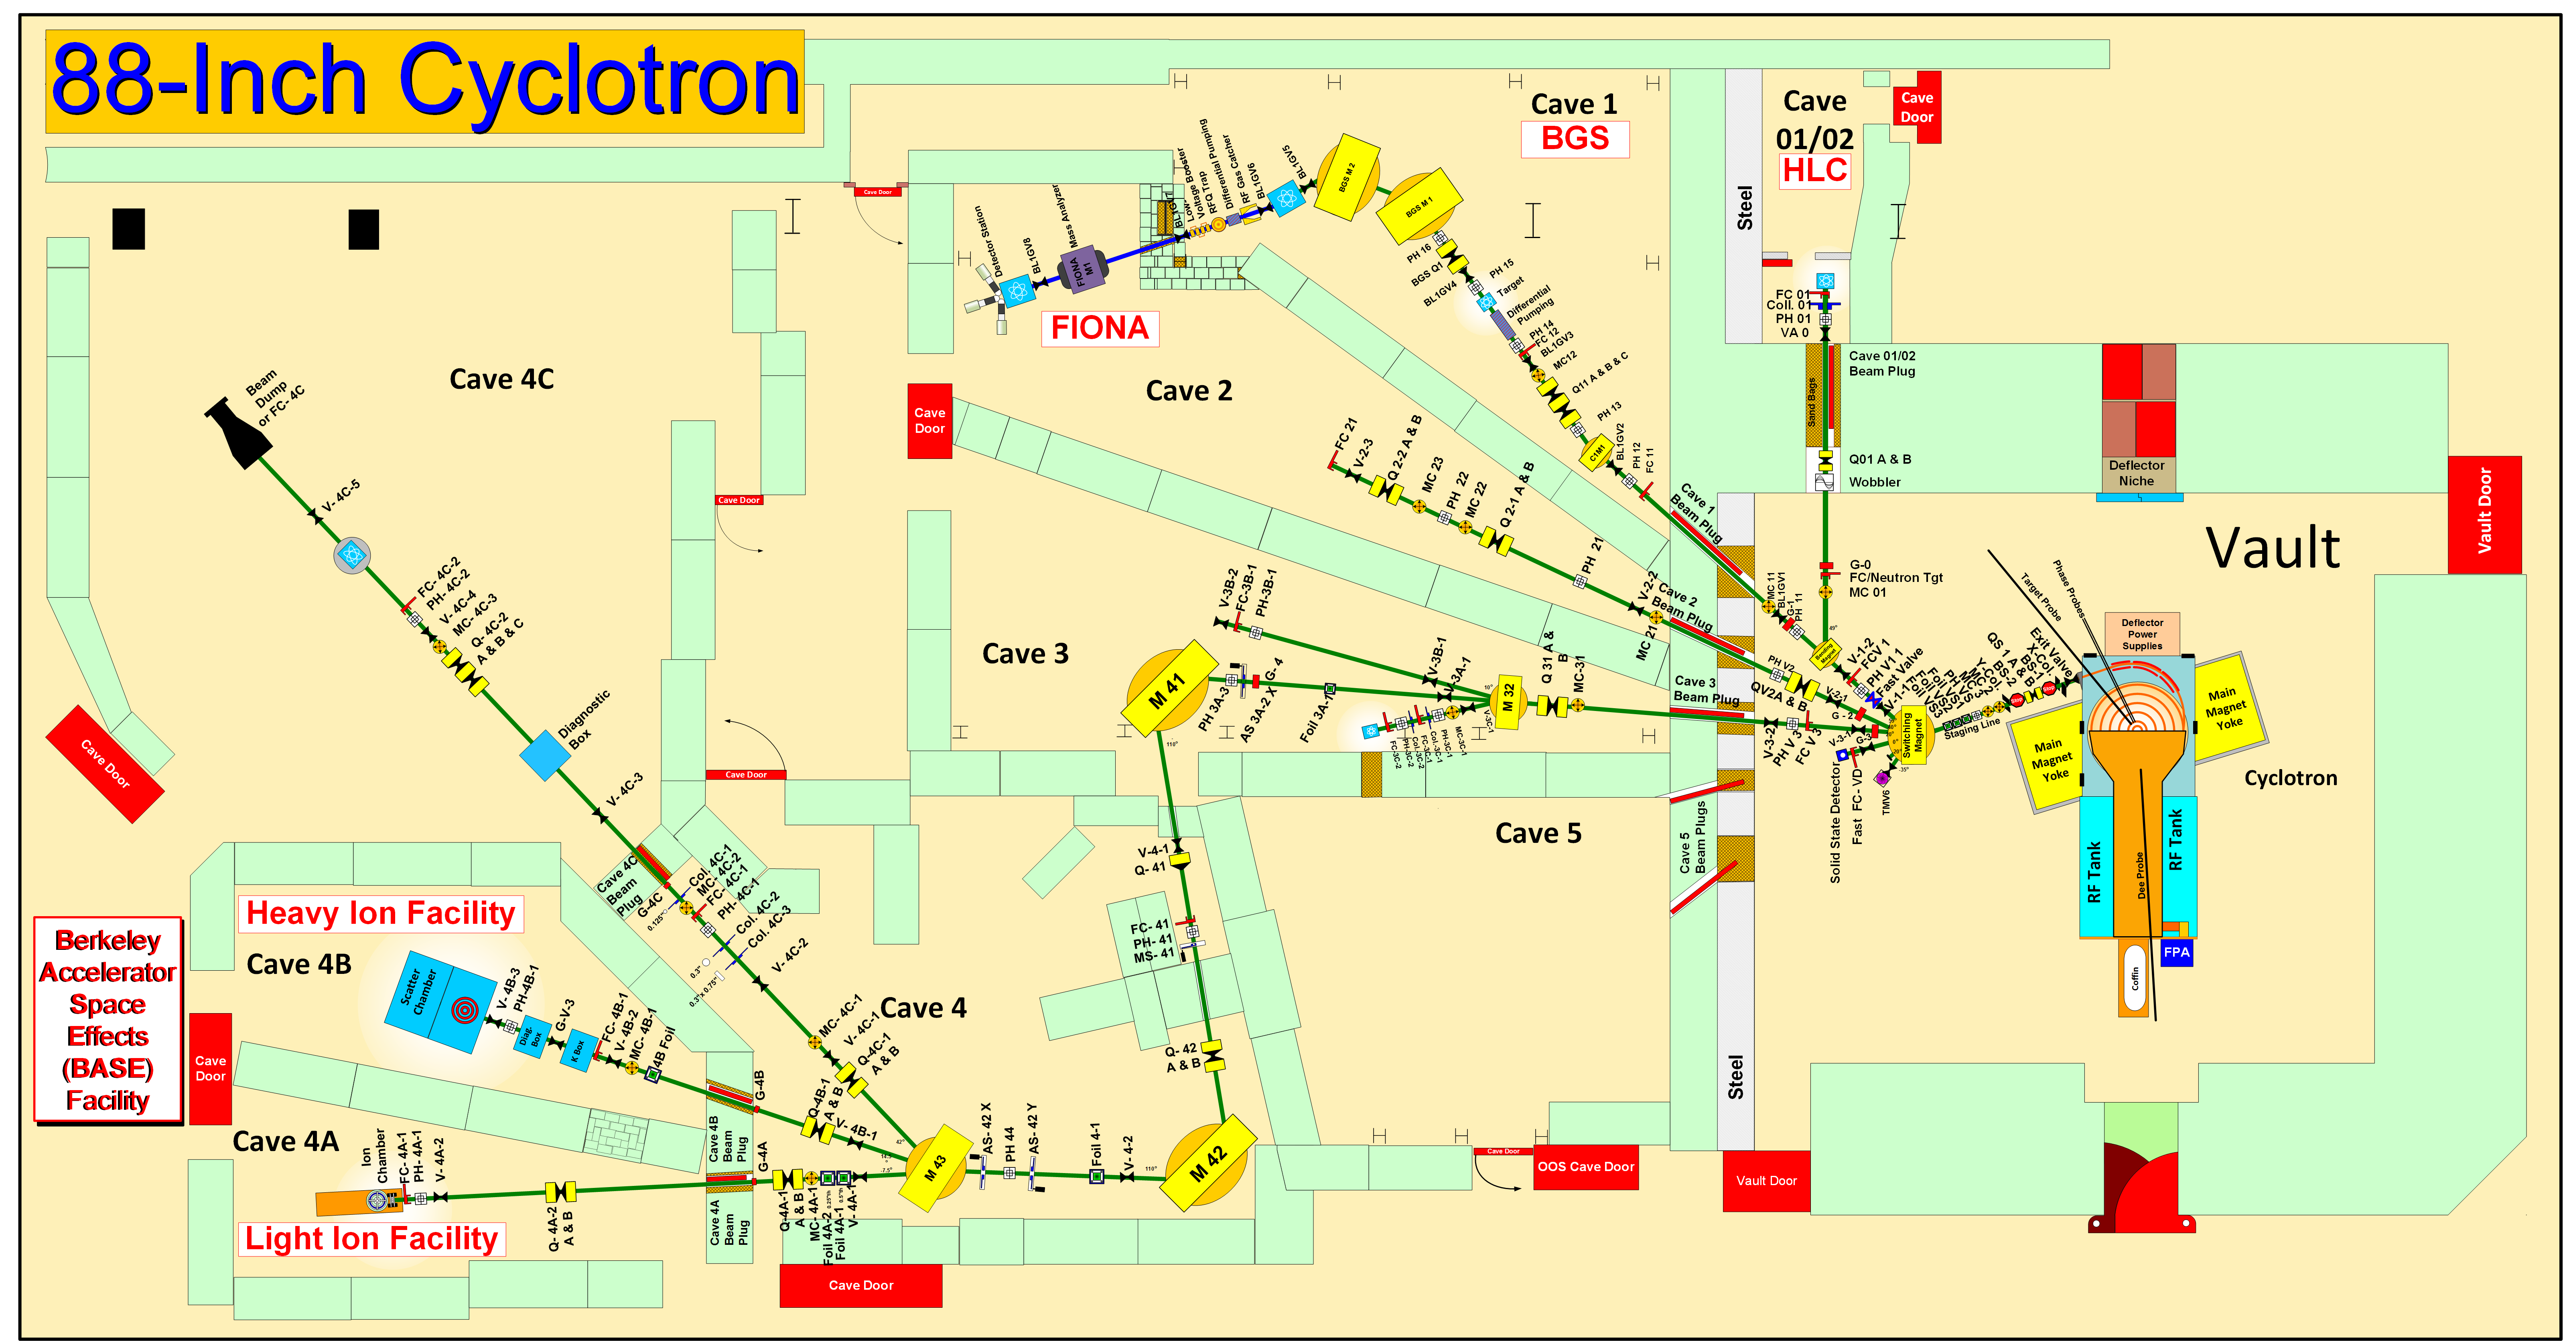
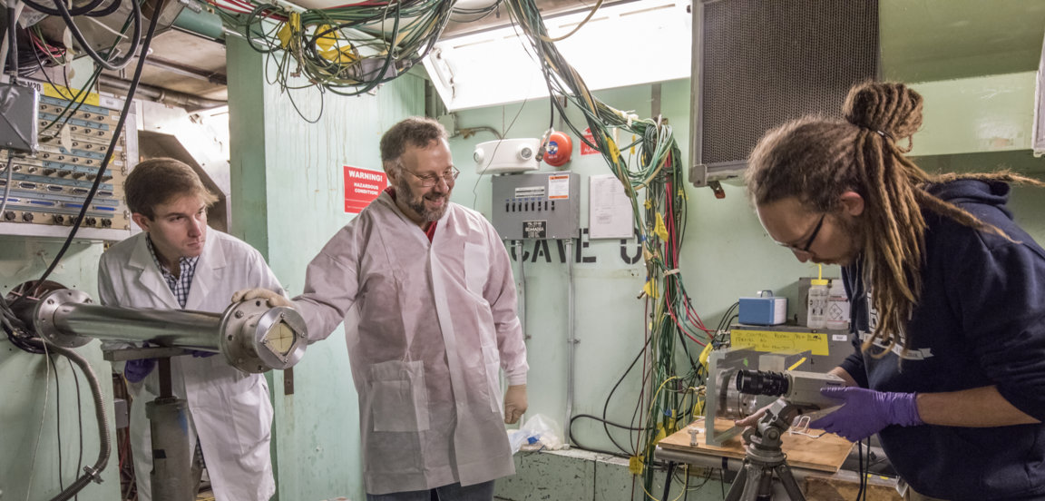
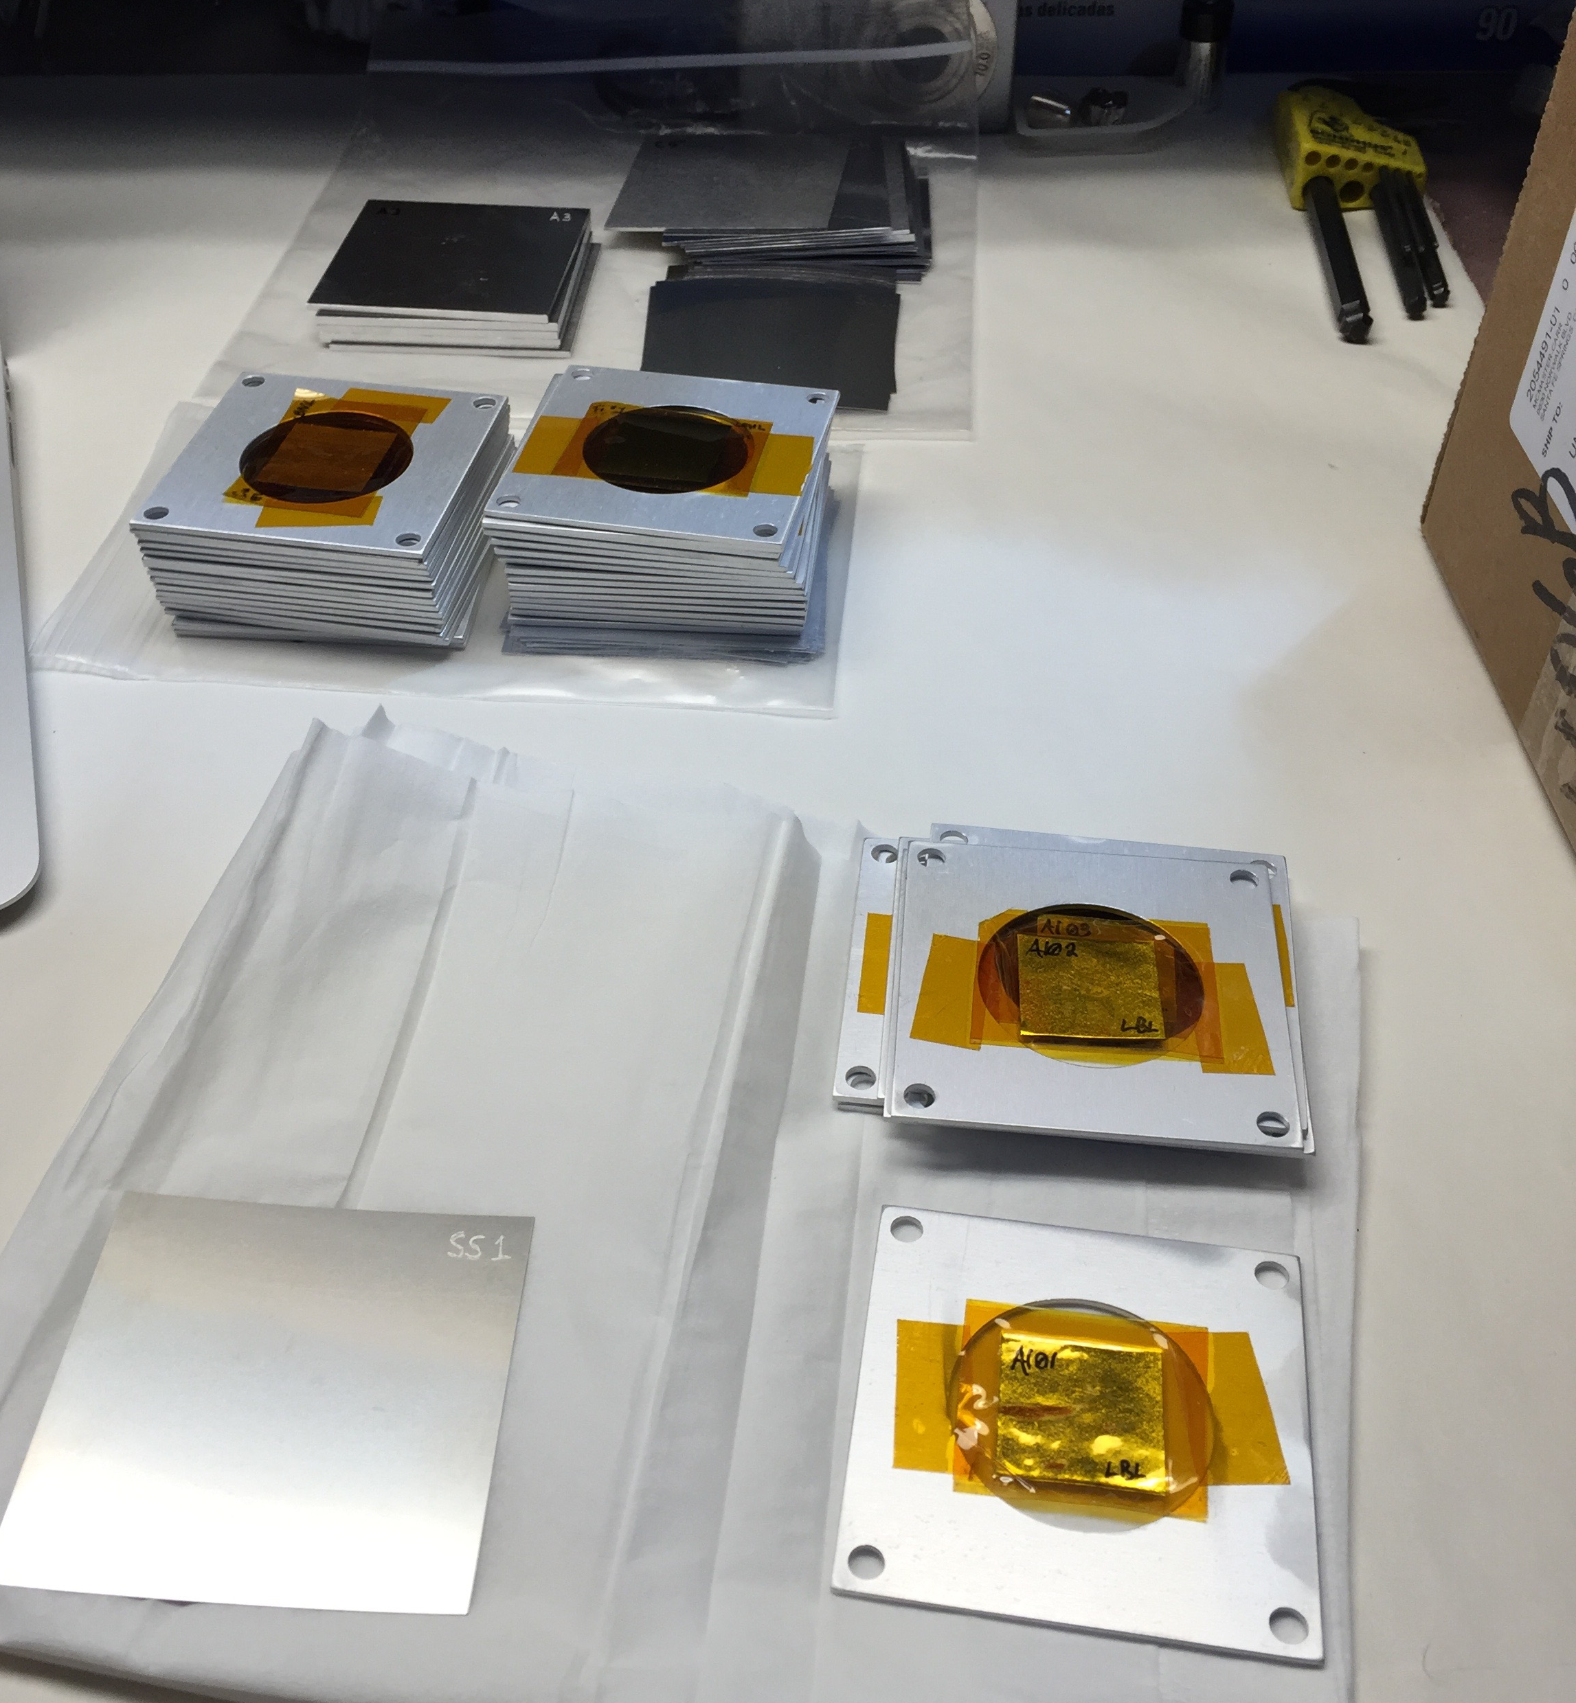
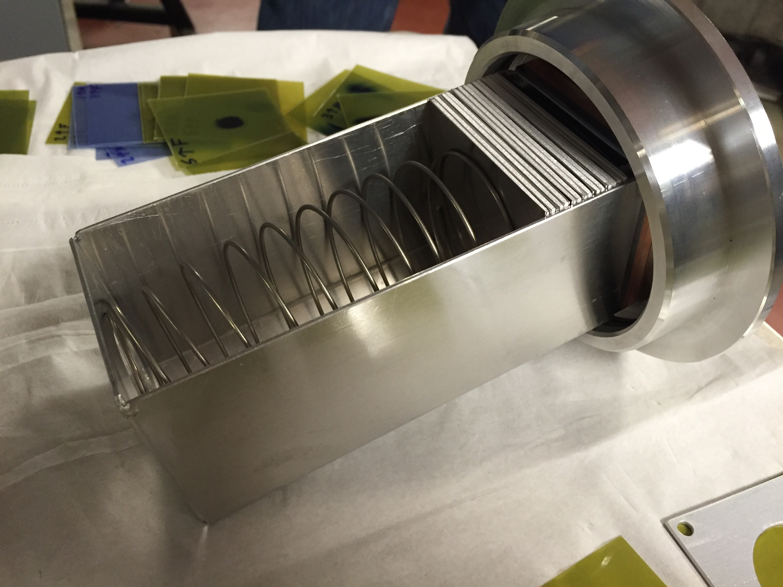
Stacked-target Charged Particle Excitation Functions
A. Springer
L. Bernstein
K-140
LBNL nuclear data measurement campaign started in Q2 2016, in collaboration with LANL
Notes:
Cyclotron freq w = Q B / m
T = (m/2) w^2 r^2
T/A = (B r / 2 m)^2 (Q/A)^2 = K (Q/A)^2

Slide 8
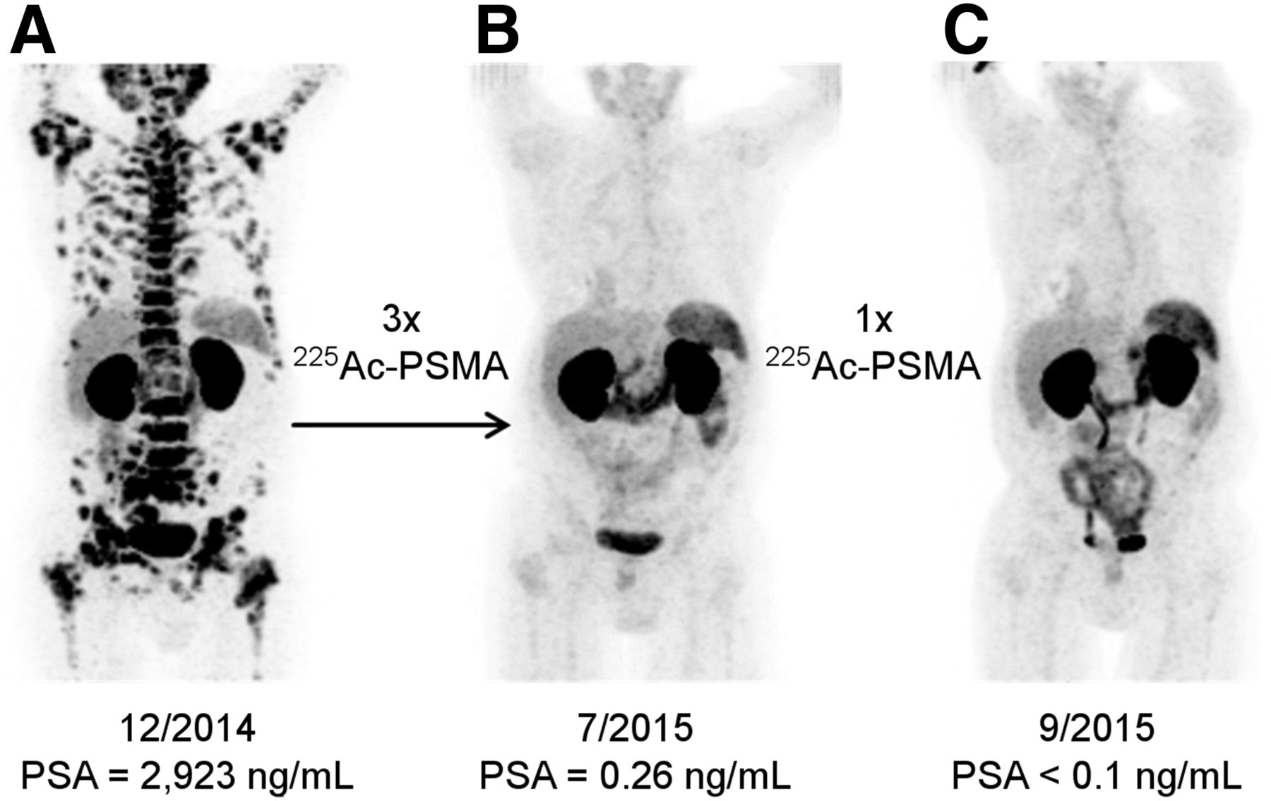
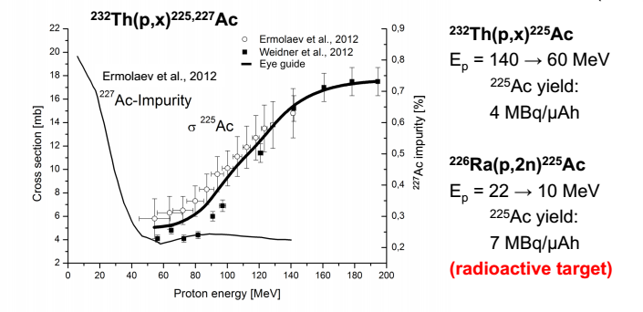
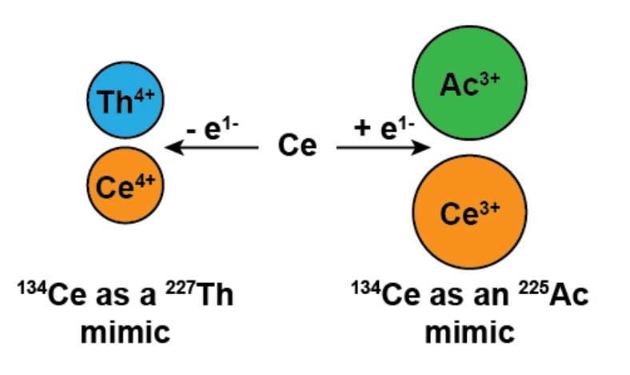
¹⁴⁰La(p,6n)¹³⁴Ce - a PET analogue for ²²⁵Ac
Kratochwil, Clemens, et al., 2016
The La/Ce project is a joint venture between LBNL/UCB (Abergel, Bernstein), LANL (Kozimor) and U. of Wisconsin (Engle)
Notes:
3x 9 MBq dose fractions
Useful for bio-kinetic studies of monoclonal antibodies (the delivery agent)
Interesting nuclear physics relevance: pre-equilibrium modelling, isomer/ground state ratios
No previous measurements, only comparison to models
Surprising results: TALYS 10x over-prediction of XS

Slide 9
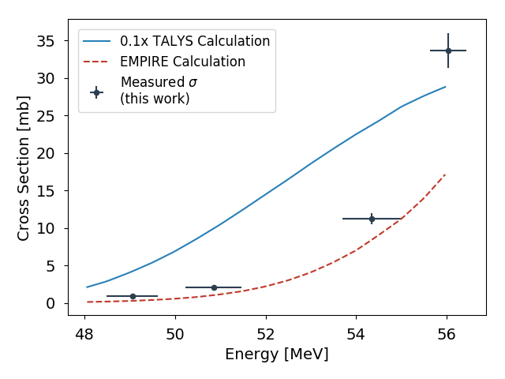
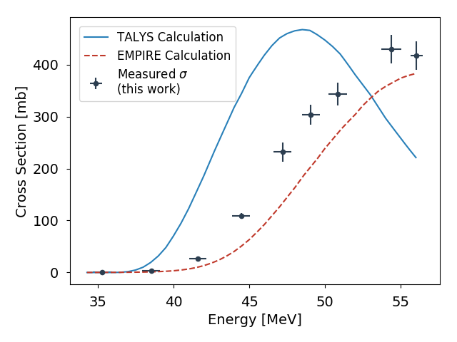
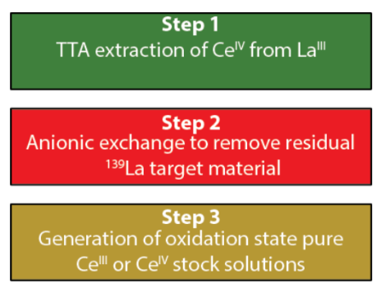

¹⁴⁰La(p,6n)¹³⁴Ce - a PET analogue for ²²⁵Ac
¹⁴⁰La(p,6n)¹³⁴Ce Cross Section
¹⁴⁰La(p,5n)¹³⁵Ce Cross Section
Preliminary
¹³⁵Ce is a contaminant isotope: higher-energy beam required for clean production of ¹³⁴Ce
Preliminary
Next steps: •Extension of data up to 100 MeV
•Design of LANL production target
• Collaborative development of radiochemical workup and uptake studies between LBNL / LANL
Jon Morrell
Notes:
3x 9 MBq dose fractions
Useful for bio-kinetic studies of monoclonal antibodies (the delivery agent)
Interesting nuclear physics relevance: pre-equilibrium modelling, isomer/ground state ratios
No previous measurements, only comparison to models
Surprising results: TALYS 10x over-prediction of XS

Slide 10
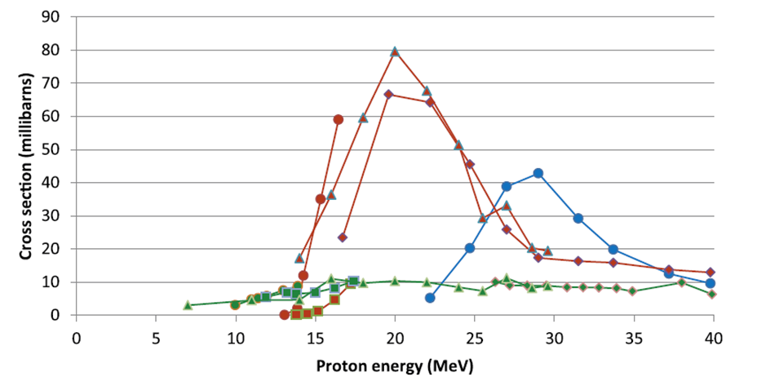
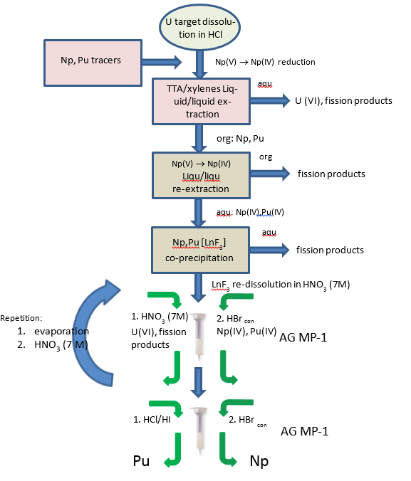
²³⁸U(p,xn)^{236,237}Np and ²³⁵U(d,x)²³⁶Np Production*
green x=1
brown x=3
blue x=4
²³⁵U(d,n)²³⁶Np w/ ^{64,67}Zn(n,p)^{64,67}Cu planned for Fall 2018!
Literature reaction cross sections for ²³⁸U(p, xn)
Vital mass-spec “spike” for nonproliferation
Provide radiochemical expertise to UCB, for potential skills transfer to IPF!
*Funded under the first Interagency Nuclear Data Working Group FOA in FY18

Slide 11
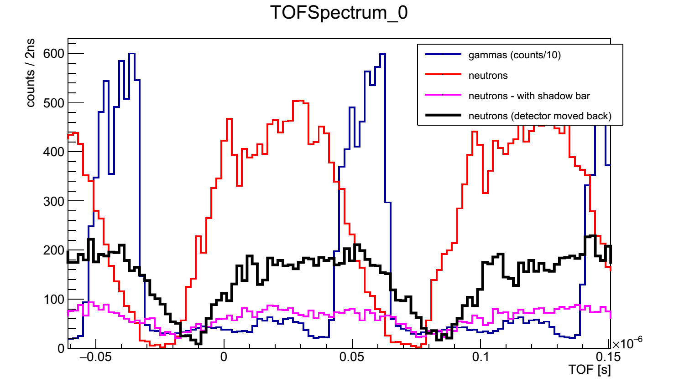
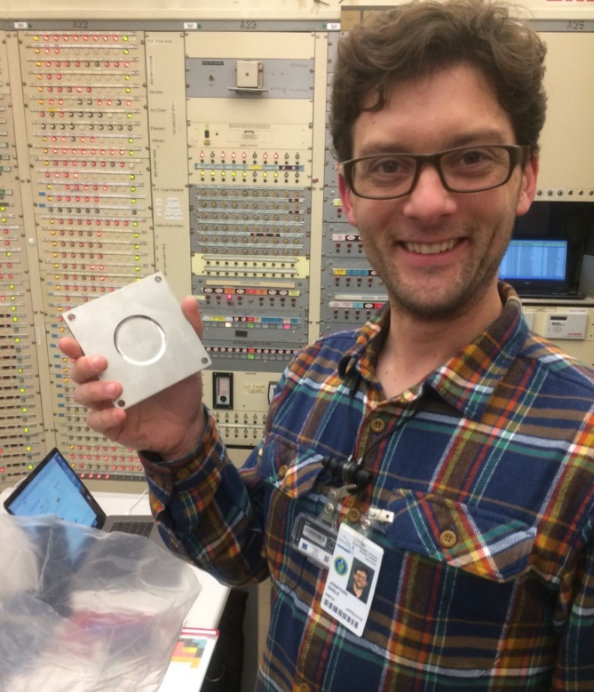
⁷Li(p,n) “Quasi-Monoenergetic” Neutron Source
Vault-based irradiation
Neutrons from 0-60 MeV
Y, Co, Al, In, Zr, Au samples irradiated in the vault
Flux from 10⁶⁻⁴ /MeV/sr/s (decreases w/E_{n})
0°
-20°
Unreacted protons
Li(p,n) neutron
production target
Inconel-clad Li targets(LANL LDRD)
First experiments took place in April 2018
Jon Engle
Notes:
This is the same method used at the new FRANZ facility in Frankfurt.

Slide 12
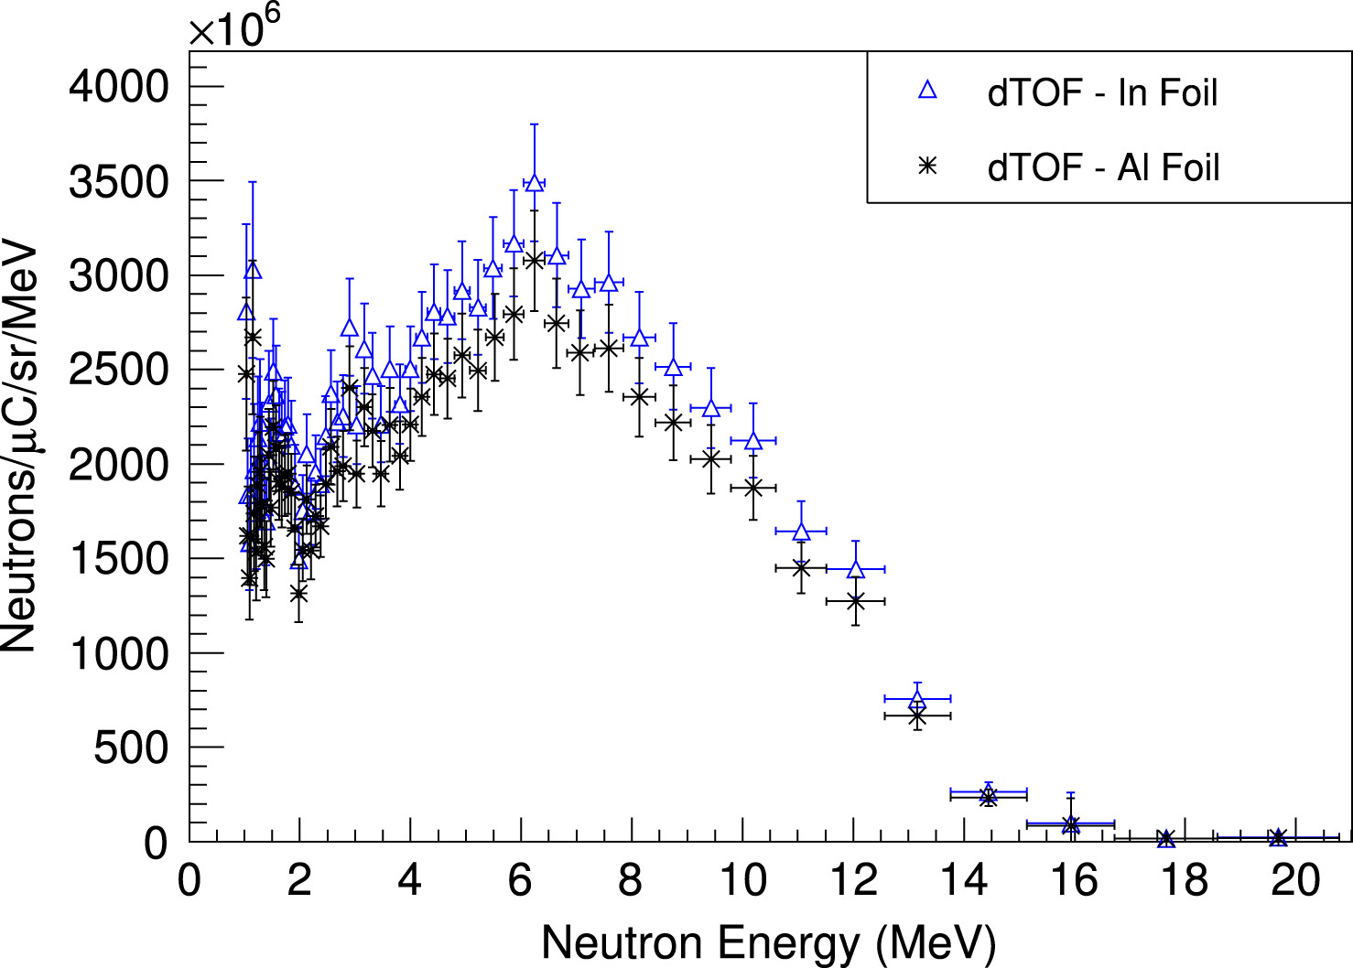
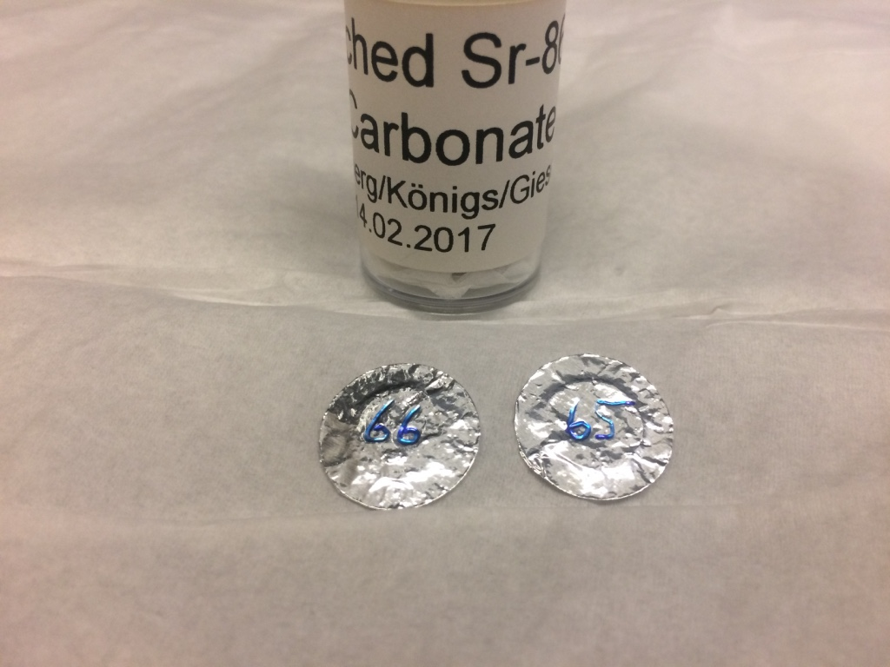
Simultaneous Radionuclide Production
≤ 50 MeV deuterons
(d,xn) target
Unreacted deuterons
Thick Be breakup target
Energetic secondary neutrons
(n,p) and/or (n,2n) target
(d,xn) reaction produces same radionuclide as commonly-used (p,n) reaction
Simultaneously makes a significant energetic secondary neutron flux (ESNF) from breakup of unreacted primary deuteron beam.
ESNF can be used to produce high specific-activity radionuclides via (n,2n), or charge exchange reactions such as (n,p) and (n,α).
²³⁵U(d,n)²³⁶Np w/ ^{64,67}Zn(n,p)^{64,67}Cu planned for Fall 2018!
[1] K. P. Harrig, et al., “Neutron Spectroscopy for pulsed beams with frame overlap using a double time-of-flight technique,” NIM A, 877, pp. 359–366, 2018.

